Slide 1
Cooking Fire Safety
Supporting BC First Nation Communities Since 1986

Slide 2
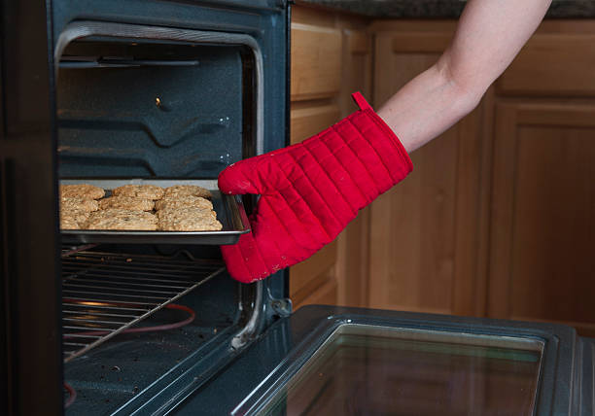
Introduction
Welcome!
Agenda
A Story
Cooking Fires & Burn Injuries
Fire Safe Cooking Practices (before, during, & after cooking)
Putting Out a Cooking Fire
Questionnaire
Refreshments & Door Prizes

Slide 3
Learning from the Past
Notes:
Share a story about a kitchen fire in your community. What caused it

Slide 4
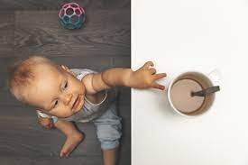
Cooking Fires & Burn Injuries
Cooking fires are a leading cause of home fires, fire and burn injuries
Most cooking fires are preventable
Babies, young children, & Elders are at highest risk

Slide 5
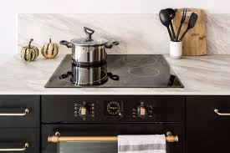
Before You Cook
Make sure kitchen counters and cooking surfaces are clean and clear of food/grease.
Keep flammables away from hot surfaces.
Maintain appliances in good working order.
Know what to do if you have a cooking fire.
Notes:
Cooking Safety Sheet, setting up your kitchen or mock kitchen for discussion

Slide 6
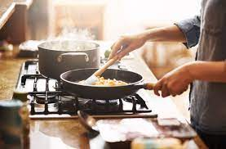
While You Cook
Keep children and pets at least 3 feet from cooking areas.
Stay in the kitchen and be alert. Cooking requires your full attention.
Check cooking food regularly and if you must leave, turn off all cooking appliances.
Remember to keep combustibles away from hot cooking surfaces.
DEMONSTRATION TIME
Notes:
SAFE COOKING PRACTICES – TURNING POT HANDLES IN, MOVING AWAY FLAMMABLES, THE 3 FOOT ZONE, LOOSE SLEEVES, timer

Slide 7
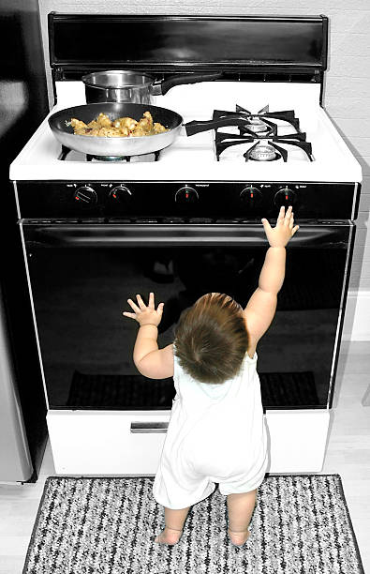
While You Cook
Prevent burns by turning pot handles in and using rear elements.
Keep hot foods and liquids away from the counter’s edge.
Use pot holders or oven mitts when touch anything that could be hot.
Avoid wearing loose fitting clothing that can catch fire.
Keep pot lids and/or a cooking sheet handy in case there is a fire.
DEMONSTRATION TIME

Slide 8
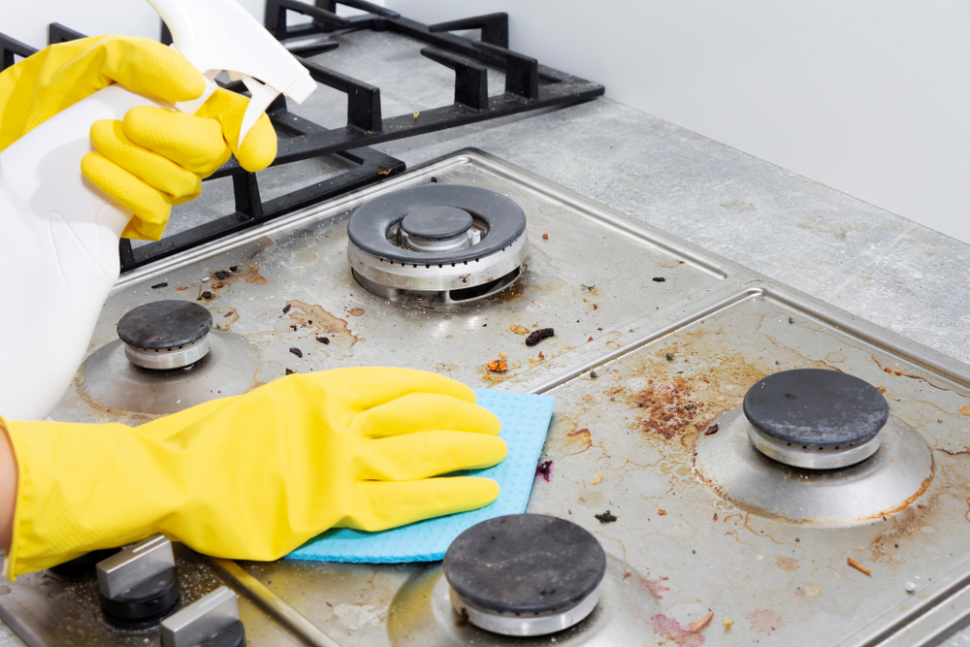
After You Cook
Turn off the oven, stove burners, and small appliances.
Wipe-up spills and splatters on the stove top, in the oven and microwave.
Do a final check that everything is off before leaving the house or going to bed.
DEMONSTRATION TIME

Slide 9
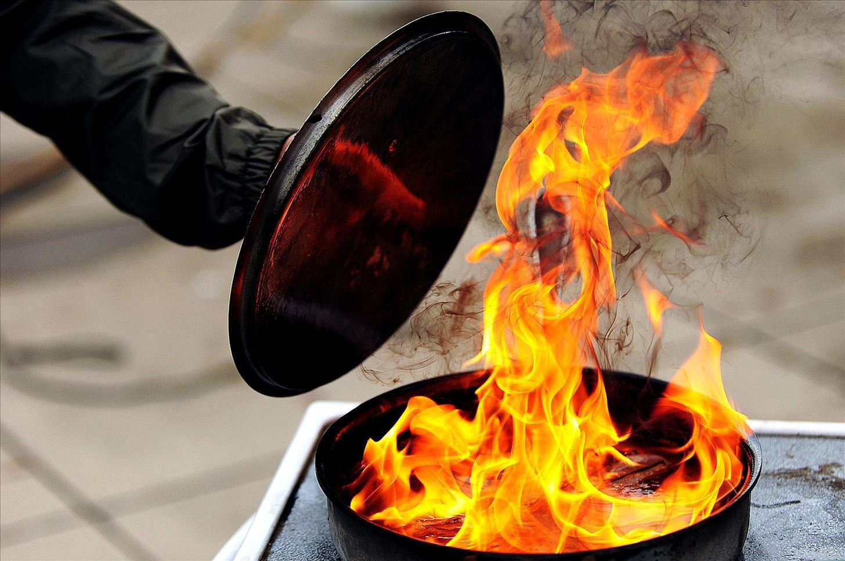
If You Have a Cooking Fire
Put safety first. If you have doubt about extinguishing the fire, get everyone out and call 9-1-1 or your local emergency number.
To put out a small grease fire, slide the lid over the pan to smother the flames then turnoff the element. NEVER put water on a grease fire!
For small oven or microwave fires, shut the door and turn off the heat.

Slide 10
Quick Questionnaire

Slide 11
Closing
Review Video
Thank you!
A few handouts to share with family
Draw prizes and refreshments!

